Slide 1


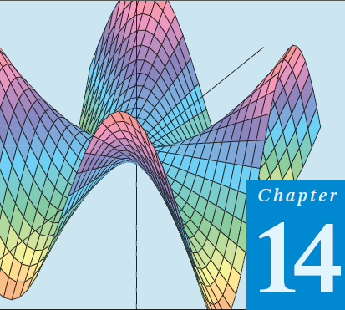
Thomas Calculus 11th
05
Chain Rules Partial Derivatives
Samuel Lukas

Slide 2
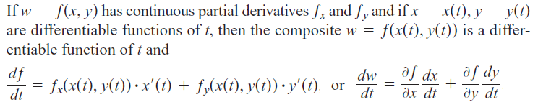



The Chain Rule
Example :

Slide 3
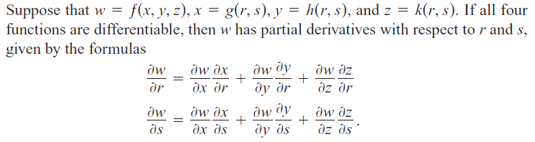

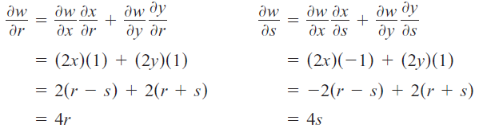

Slide 4
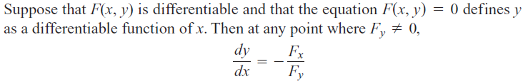


Slide 5

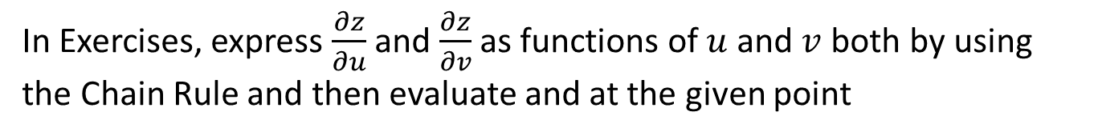
Exercises 1
In Exercises, express dw/dt as a function of t
In Exercises, express $\frac{∂z}{∂u}$ and $\frac{∂z}{∂v}$ as functions of $u$ and $v$both by using the Chain Rule and then evaluate and at the given point

Slide 6
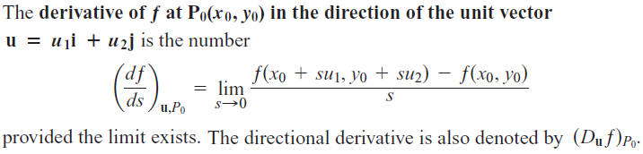

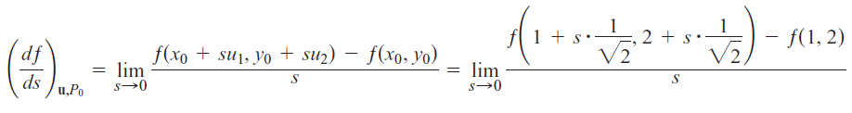
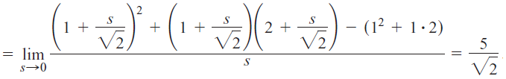
Directional Derivatives

Slide 7
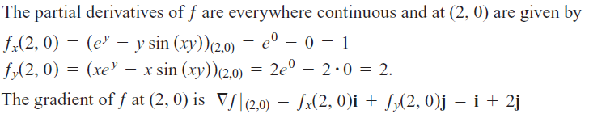

Gradient Vectors

Slide 8




Function of Three Variables
Example :

Slide 9


Exercises 2

Slide 10
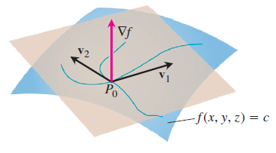
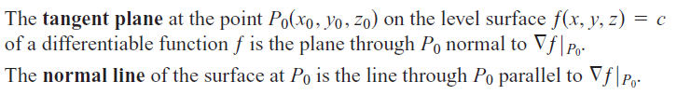
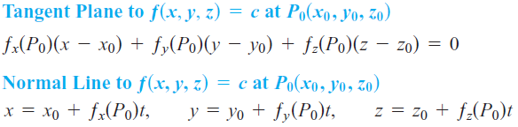
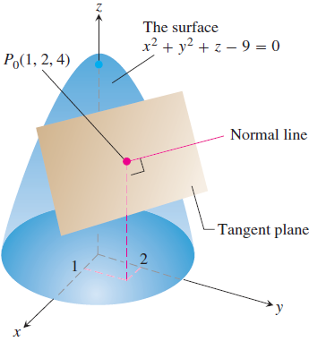

Tangent Planes and Differentials
Exercise :

Slide 11
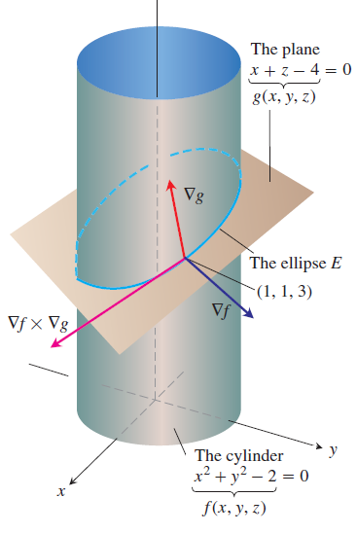
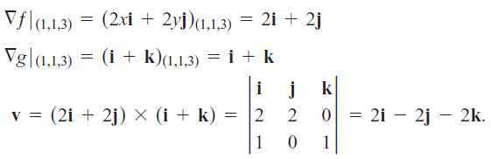

Tangent Line to the Curve of Intersection of Two Surfaces
Example :

Slide 12

Total Differential
Example :
Your company manufactures right circular cylindrical molasses storage tanks that are 25 ft high with a radius of 5 ft. How sensitive are the tanks’ volumes to small variations in height and radius?
The tank’s volume is 10 times more sensitive to a small change in r than it is to a small change of equal size in h.

Slide 13


Exercises 3
Find equations for the tangent plane and normal line at the point on the given surface.
Find parametric equations for the line tangent to the curve of intersection of the surfaces at the given point.

